Slide 1

ChinaCarb Simulation
By Phillip Frederick

Slide 2
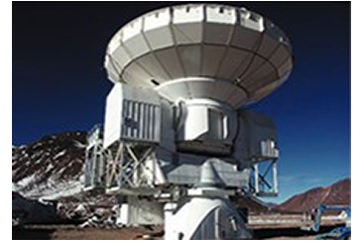
Who is ChinaCarb?
Background Information
Produces pitch based carbon fiber
Product has various applications
E.g. Aerospace, Automotive Industries

Slide 3
Two Potential Options
Use remaining supply of pitch until it runs out the following year
Acquire the pitch technology from European chemical company for 1 million RMB
Proceed to build pitch plant and assume working capital costs of 5 million dollars at a 3% annual increase

Slide 4
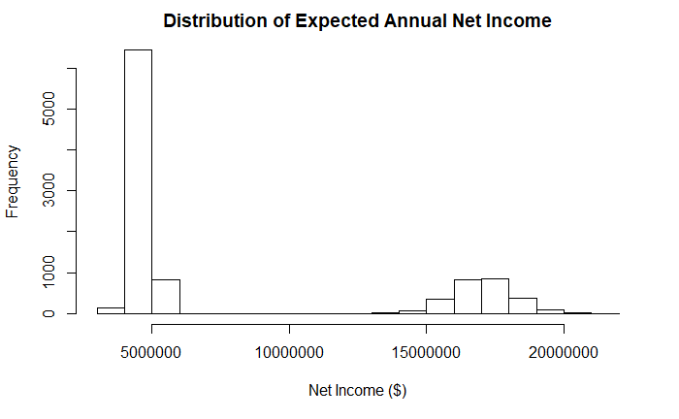
Simulation Outcome
Should ChinaCarb purchase the pitch technology and should they build the pitch plant?
Develop a histogram of the Expected Annual Net Income and compare the expected value to estimate provided in case.
Should ChinaCarb possibly adjust their Risk Tolerance level if large differences surface?
88% decrease in expected annual income compared to the 2011 estimate

Slide 5
Forecasting Raw Material Cost
Year | Forecast ($)
2011 | 3774.94
2012 | 3850.49
2013 | 3926.05
2014 | 4001.60
2015 | 4077.15
2016 | 4152.71
2017 | 4228.26
2018 | 4303.81
2019 | 4379.37
2020 | 4454.92
2021 | 4530.48

